Slide 1
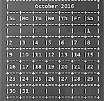
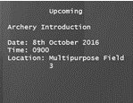
SmartyDo
New task added: Archery
>> Add /d Archery Introduction /st 0900 /loc Multipurpose Field 3

Slide 2
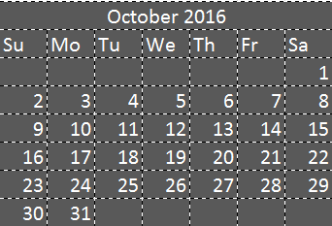
SmartyDo
Upcoming
Task Deleted : Archery Introduction
>> delete 1

Slide 3
SmartyDo
Upcoming
Your previous action delete 1 has been executed
>> Redo

